Slide 1
Personalized Nutritional
Analyzer
REDDY TANVIK SRI RAM
URK23CS1261
Batch 5

Slide 2
Nutrition Mission:
Finding the diet information and providing good diet percentage.
Problem Statement

Slide 3
ABSTRACT
"My program offers detailed nutritional analysis
for informed dietary decisions and healthy
lifestyle choices."

Slide 4
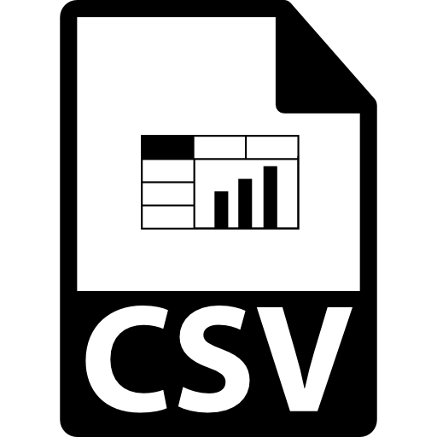





Functionalities
Reading Data
Nutritional Value Calculation
Fetches nutritional details from a file.
Computes total calories, protein, fat, saturated fat, fiber, and carbohydrates for specified items.
Displaying Available Items
Diet Quality Assessment
Presents a user-friendly list of food items from the file.
Evaluates a user's diet based on predefined nutritional thresholds.
User Input and Checking
Memory Management
Accepts user-specific food items for comparison.
Ensures efficient allocation and release of memory resources.

Slide 5
01 Nutritional Understanding
The program facilitates a better grasp of food nutrition, emphasizing its impact on overall health.
02 Evaluation of Food Choices
Allows users to assess their dietary preferences, making informed decisions for healthier eating habits.
03 Application in Health Management
Offers a practical tool for managing personal health by aligning food choices with recommended nutritional standards.

Slide 6
INTRODUCTION
1
The presentation introduces the "Personalized Nutritional Analyzer" program, addressing gaps in nutritional awareness, health implications of dietary choices, and the necessity for informed decision-making program.

Slide 7
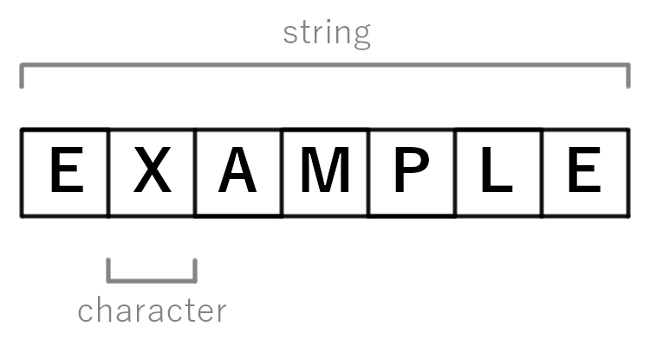
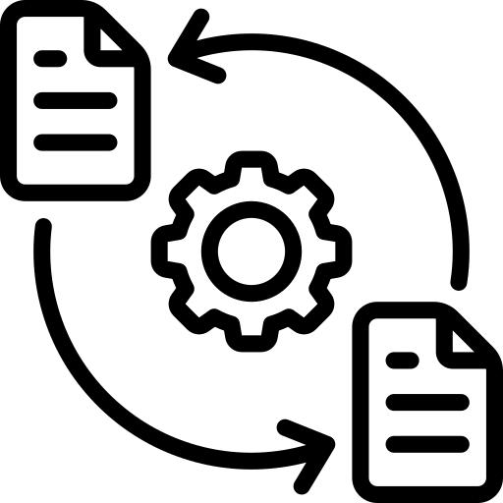




Overview
File Handling
String Manipulation
Reading and parsing data from external files containing nutritional information.
Techniques for string cleaning, parsing, and comparison.
Structures
User Interaction
Utilizing structures to organize and store food item attributes in a coherent manner.
Using console I/O to interact with users for input and display purposes.
Memory Management
Algorithmic Logic
Efficient allocation and deallocation of memory using dynamic memory allocation.
Calculating total nutritional values, matching user inputs with stored data, and assessing diet quality based on predefined thresholds.

Slide 8
SYSTEM DESIGN
2
The system design incorporates file reading, data parsing, user interaction, nutritional analysis, and memory management, ensuring a comprehensive tool for dietary assessment and informed decision-making.

Slide 9
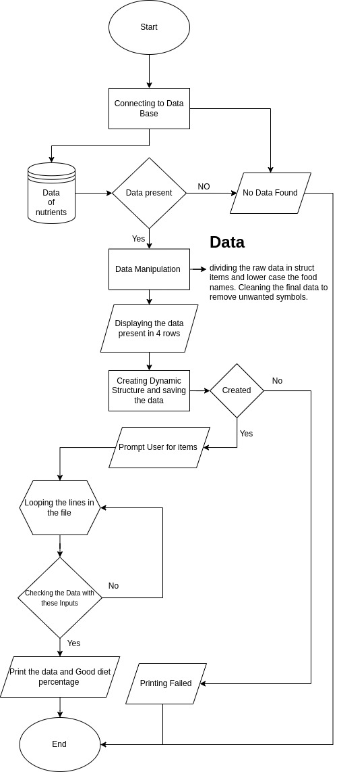

Slide 11




01
03
Display Functionality
Struct Definition
Defining a structure for storing food item nutritional data.
Showing available food items in a structured, user-friendly manner.
02
04
File Reading & Data Parsing
User Interaction
Reading files and parsing nutritional data for analysis and evaluation.
Interacting with users to input and analyze food item data.

Slide 12




05
Data Processing & Analysis
07
Memory Management
Processing data to calculate nutritional values for dietary analysis.
Allocating and freeing memory for the structured array of food items.
06
08
Diet Quality Assessment
Error Handling
Evaluating diet quality based on nutritional thresholds for user-input foods.
Handling memory allocation failure and ensuring program execution stability.

Slide 13
FEASIBILITY ANALYSIS & REAL TIME APPLICATIONS
3
The feasibility analysis assesses tool usability, efficiency, and adaptability, evaluating its practicality in real-time dietary assessment, enabling informed decisions for healthier eating habits.

Slide 14
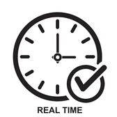

Feasibility Analysis
Assessing tool usability, efficiency, and adaptability.
Real-Time Application
Practicality in immediate dietary assessment for informed, healthier eating habits.
Evaluation Metrics
Metrics for measuring tool effectiveness in real-world dietary contexts.

Slide 15
Limitations
Data Accuracy
Generalized Thresholds
Limited Food Database
The accuracy of nutritional information depends on the data source's reliability, potentially impacting the program's results.
Healthy thresholds used for evaluation might not suit everyone's dietary needs, lacking personalized adjustments.
The program’s effectiveness is constrained by the database's scope and may not cover all available food items or regional cuisines.

Slide 16
Exploring nutritional analysis practicality and applicability in daily diets is at the core of our discussion.

Slide 17
Reference Links:
For Dataset:https://www.kaggle.com/datasets/niharika41298/nutrition-details-for-most-common-foods/
For Flowchart:
https://app.diagrams.net
For Idea on Data:
https://pubmed.ncbi.nlm.nih.gov
https://www.fao.org/nutrition/education/food-dietary-guidelines/regions/countries/india
https://www.mayoclinic.org/healthy-lifestyle/weight-loss/in-depth/mayo-clinic-diet/art-20045460
https://www.ncbi.nlm.nih.gov/pmc/articles/PMC7071223/
https://www.health.harvard.edu/topics/nutrition
https://www.medicalnewstoday.com/articles/160774#macronutrients

Slide 18

Let's experience the code in action
https://github.com/Bookinheaven/BK-Hub/tree/main/PPS/Idea%20Presentaion/FOOD/

Slide 19


